Slide 1

Milton Keynes Falcons
Season Sponsorship Opportunities
2025/2026

Slide 2



Mission & Vision
Vision:
Our vision is to grow our team, strengthen our community, and be a leading force in women’s ice hockey—driven by pride, passion, and determination.
Mission:
We are dedicated to creating a safe, inclusive, and empowering environment where women and girls can connect, grow, and thrive through ice hockey—celebrating confidence, camaraderie, and the joy of the game.

Slide 3

Built on Passion
Our team runs on heart, hustle, and community—not big budgets.
Our coaches and management generously volunteer their time to train, mentor, and support our players.
Each player personally covers the cost of their equipment and travel, demonstrating incredible dedication to the game.
Your support helps keep us on the ice and proudly representing our community. Every contribution goes directly toward essentials like ice time, uniforms, and tournament entry fees—ensuring our team stays game-ready.
Together, we make it possible.
Your brand, your reach, your impact — growing together with the MK Falcons.

Slide 4
Why This Matters?
Sponsoring a women’s hockey team is a meaningful way to support women in sport and champion gender equality.
Your sponsorship helps create valuable opportunities for female athletes while raising your brand’s profile within a passionate, engaged community.
By aligning with a team built on hard work, resilience, and teamwork, your company signals a strong commitment to empowerment and inclusion—sending a powerful message to customers, employees, and stakeholders alike.
Beyond branding, sponsorship fosters real connections with players, fans, and the wider community—building goodwill that supports long-term business success.
Your brand, your reach, your impact — growing together with the MK Falcons.

Slide 5
Community & Social Impact
At Milton Keynes Falcons, we are proud to be aligned with England Ice Hockey (EIH) and share their commitment to developing the sport at every level. We believe in creating opportunities both on and off the ice and are dedicated to building a positive, inclusive environment for players and the wider community.
We actively support the next generation of athletes by assisting with coaching for the U16 Storm Girls Team, helping young players build confidence, skills, and a lifelong love for the game.
This season, we are also excited to welcome Girl Pack as a community partner. Girl Pack is a UK-registered, volunteer-led charity based in Milton Keynes, dedicated to promoting period dignity. They provide emergency period packs and menstrual products to schools and community groups across the region and beyond.
Through this partnership, we aim to raise awareness, reduce stigma, and stand alongside girls and women in both sport and society. Together, we are building a stronger, more supportive hockey community—one that empowers women at every stage of their journey.

Slide 6

Our Growing Reach
Looking Ahead
Our partnership with Internet 123 will help us:
Boost sponsor visibility
Grow our fanbase locally and online
Promote women’s hockey to new audiences
Current Snapshot (2024–25 Season):
🌐 Website traffic: Modest, steadily increasing
📱 Social media following: 1500+ combined followers
👥 Game attendance: 30–50 supporters per match
Building Momentum with Internet 123
We’re working with Internet 123, a digital marketing partner, to:
Redesign our website and improve SEO
Develop consistent and engaging social content
Launch targeted outreach campaigns
Share behind-the-scenes video and player stories
Your brand, your reach, your impact — growing together with the MK Falcons.

Slide 7
Partnering
With Us
At the Milton Keynes Falcons, we understand that every sponsor has unique goals, audiences, and values. That’s why we offer flexible, bespoke sponsorship packages designed to align with your brand and deliver maximum value.
Whether you're looking to increase visibility, support grassroots sports, or connect with the local community, we’ll work with you to create a package that meets your needs.
We offer tailored opportunities such as:
Brand placement on jerseys, helmets, and equipment
Recognition on our website and social media platforms
Shout-outs during match days and local events
Collaborative ideas, such as giveaways or community initiatives
Mentions in club announcements and local media features (where possible)
Community connection, including opportunities to meet players or attend team events
By partnering with us, you're not just gaining brand exposure—you’re joining a movement to empower women and girls through sport.
Let’s talk about how we can build a partnership that works for you.

Slide 8

We offer a range of sponsorship tiers to give partners clear options and value at every level. Our packages are designed to suit different budgets and goals—but we’re also happy to create bespoke opportunities tailored specifically to your brand.
Tier Examples:
TIER | TYPICAL BENEFITS
PLATINUM £ 7000.00 | Your logo on main body of the team jersey (home & away) + personalized jersey Your logo on team short covers and helmets Company tagged in bio as main sponsor, and social media mentions throughout the season (approx. 30 games) Player of the game sponsor and pen box sponsor at home games (approx. 15 games) Team photo and Falcons puck
GOLD £5000.00 | Your logo on the team jersey (home & away) + personalized jersey Your logo on team helmets Social media mentions throughout the season (approx. 30 games) Team photo and Falcons puck
SILVER £2500.00 | Your logo on the team jersey (home OR away) + personalized jersey Your logo on team helmets Social media mentions throughout the season (approx. 15 games) Team photo and Falcons puck
BRONZE £1500.00 | Your logo on team short covers and helmets Social media mentions throughout the season (approx. 30 games) Team photo and Falcons puck
PURPLE £3500.00 | Your logo on players off ice kit: t-shirt, joggers, and hoodie

Slide 9
Where Your Support Goes
Sponsorship plays a vital role in helping the Milton Keynes Falcons grow, compete, and create opportunities for women and girls in ice hockey.
Your support directly contributes to essential costs such as:
🔹 Ice Time & Rink Fees
Securing regular training and match slots is our biggest ongoing expense.
🔹 Uniforms & Team Apparel
Help us maintain a professional, unified appearance on and off the ice.
🔹 Tournament Entry Fees
Funding allows us to compete in regional and national events that elevate player development and club visibility.
🤝 Your Impact
By sponsoring the Falcons, you’re not just covering costs—you’re reducing the financial burden on players, supporting grassroots women’s sport, and helping us reach the next level.
Your brand, your reach, your impact — growing together with the MK Falcons.

Slide 10
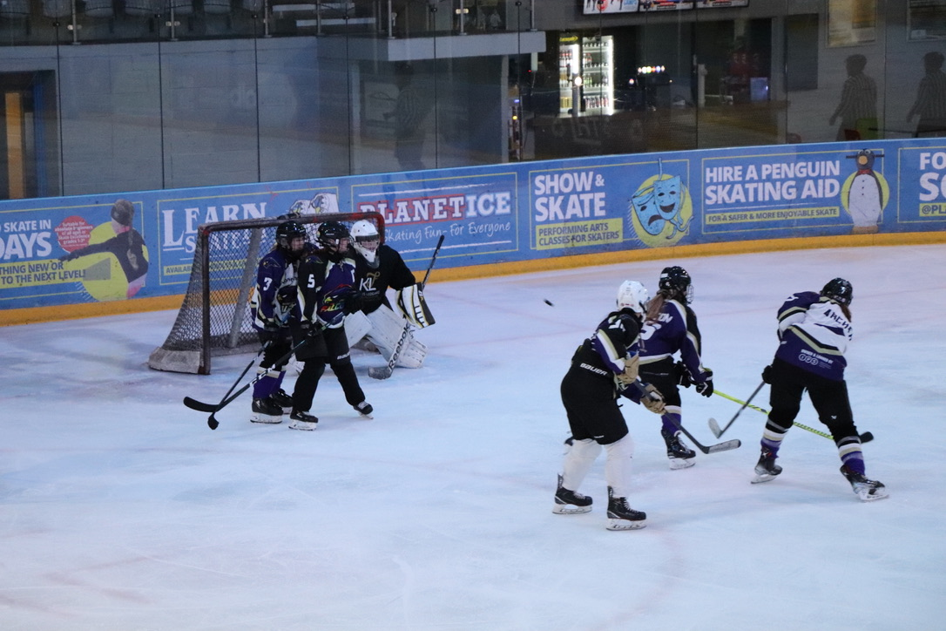
Call to Action
We’d love to partner with you and proudly showcase your business throughout our 2025–26 season.
Let’s connect and explore how we can create a partnership that’s rewarding for both of us.
📩 Contact Us
Primary Contact: Martin Waters
Email: MiltonKeynesFalcons@outlook.com
Facebook: Milton Keynes Falcons
Instagram: @mkfalcons
Website: www.mkfalcons.com
Your brand, your reach, your impact — growing together with the MK Falcons.

